Slide 1
Emergency Call
101.455 Modellig and Simulation
2016W
Group 14

Slide 2
Content
Software Used
Task Description
Implementation
Statistics
Demo
References

Slide 3

Software Used
Simulation tool that supports
System Dynamics
Discrete Events
Agent-Based

Slide 4

Task Description
Call received every 50 min
Normal patients and life-threatening patients
Calls are collected in queue
Doctor receives the address of the patient and treats him

Slide 5
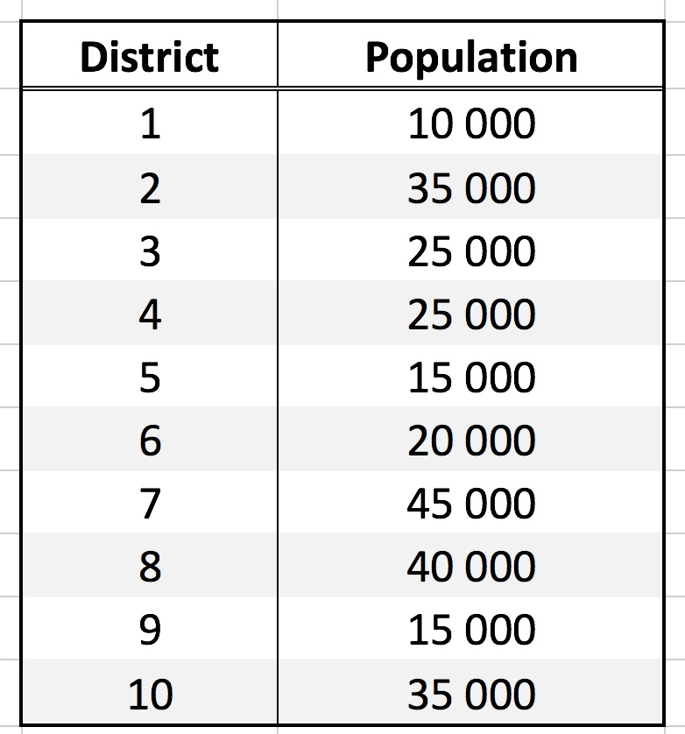
Task Description
Population in the districts

Slide 6
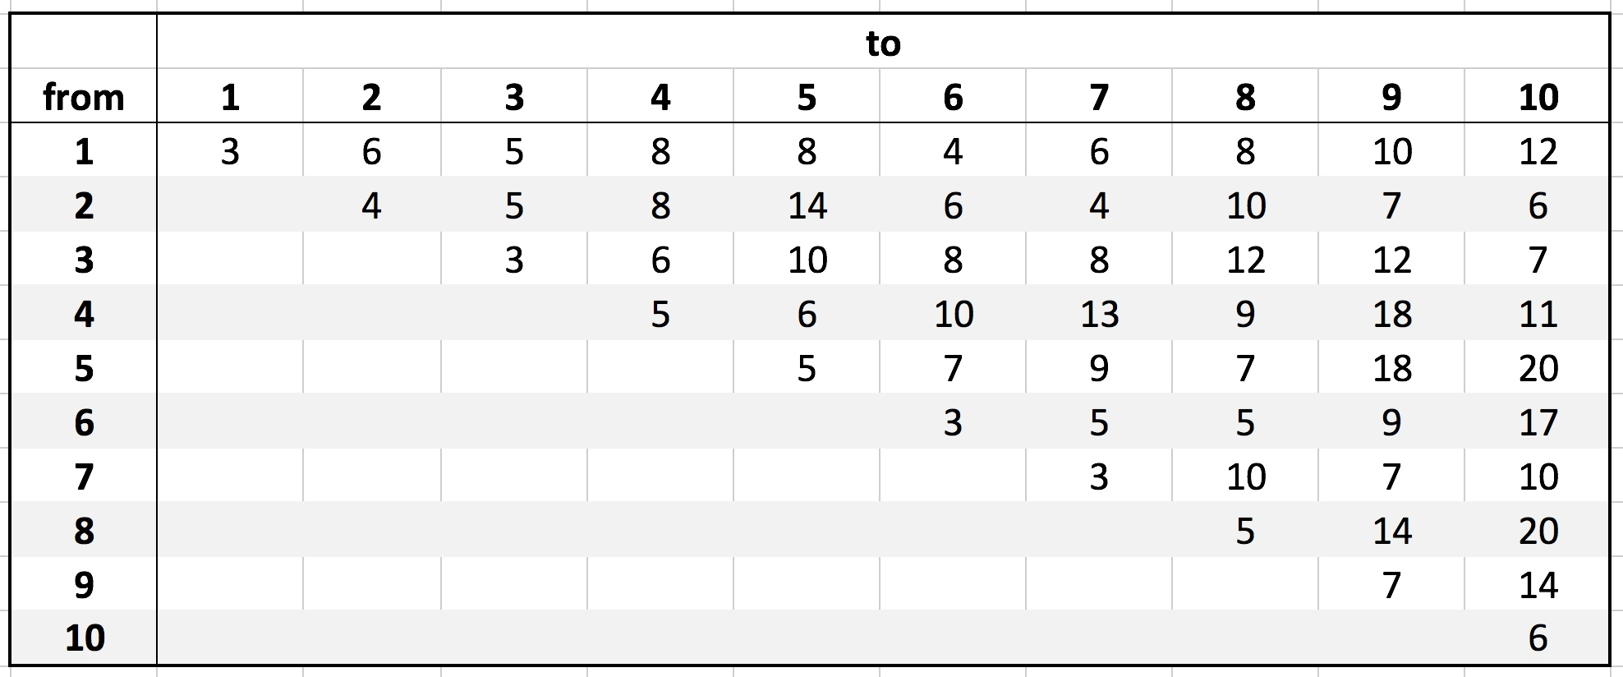
Task Description
Average driving time between districts in minutes

Slide 7
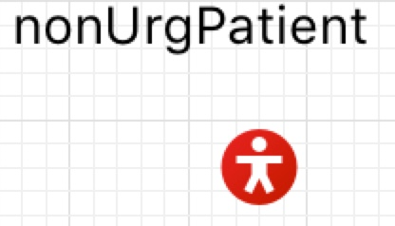
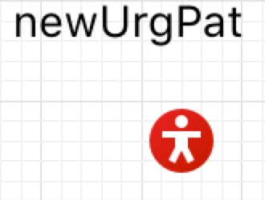
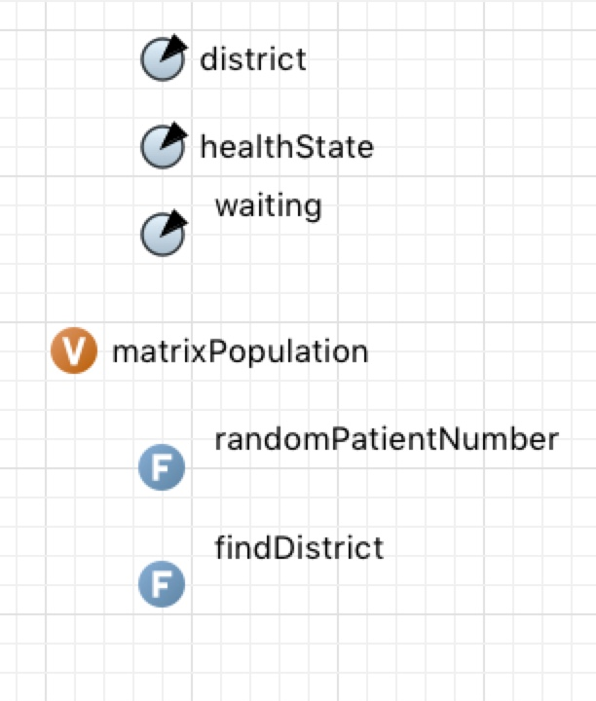
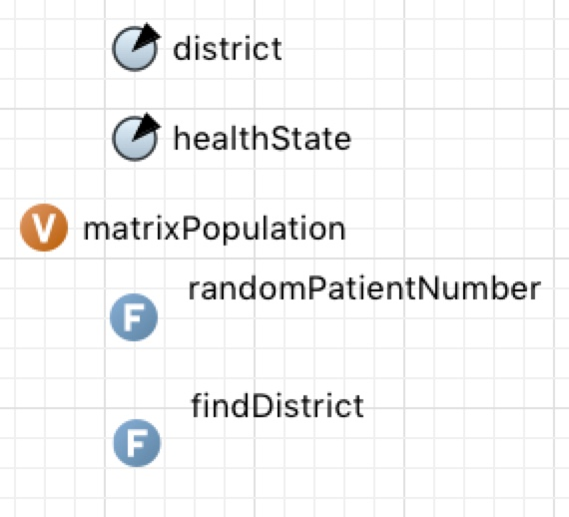
Implementation

Slide 8
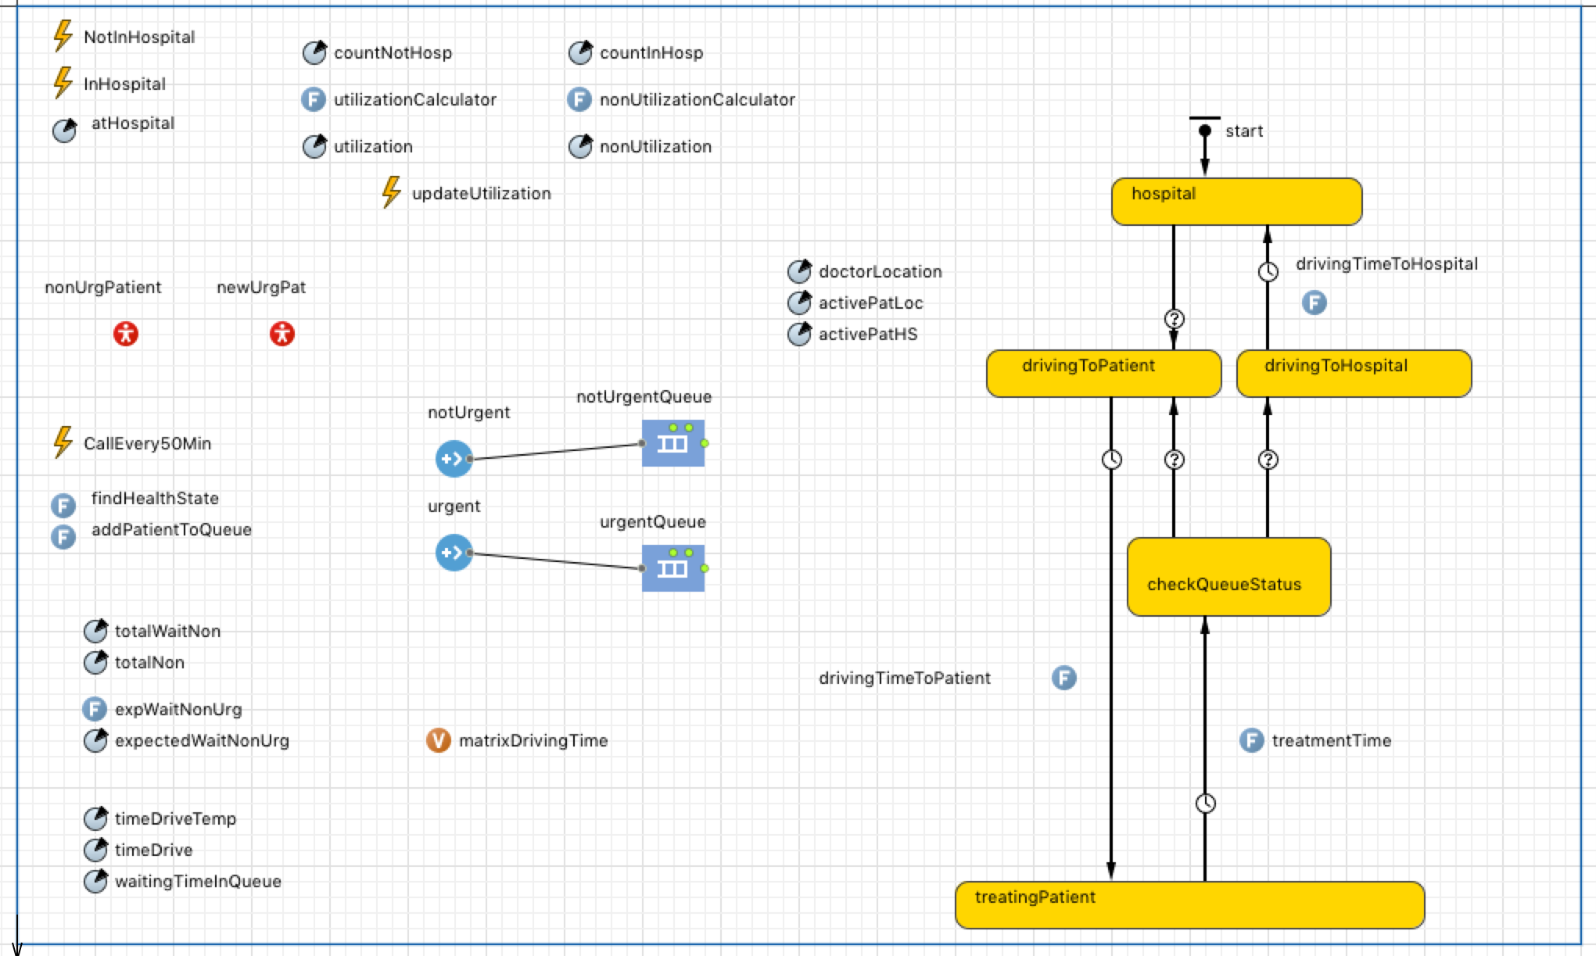
Implementation
callEvery50Min Event

Slide 9
Implementation

Slide 10
Implementation

Slide 11
Implementation

Slide 12
Implementation

Slide 13
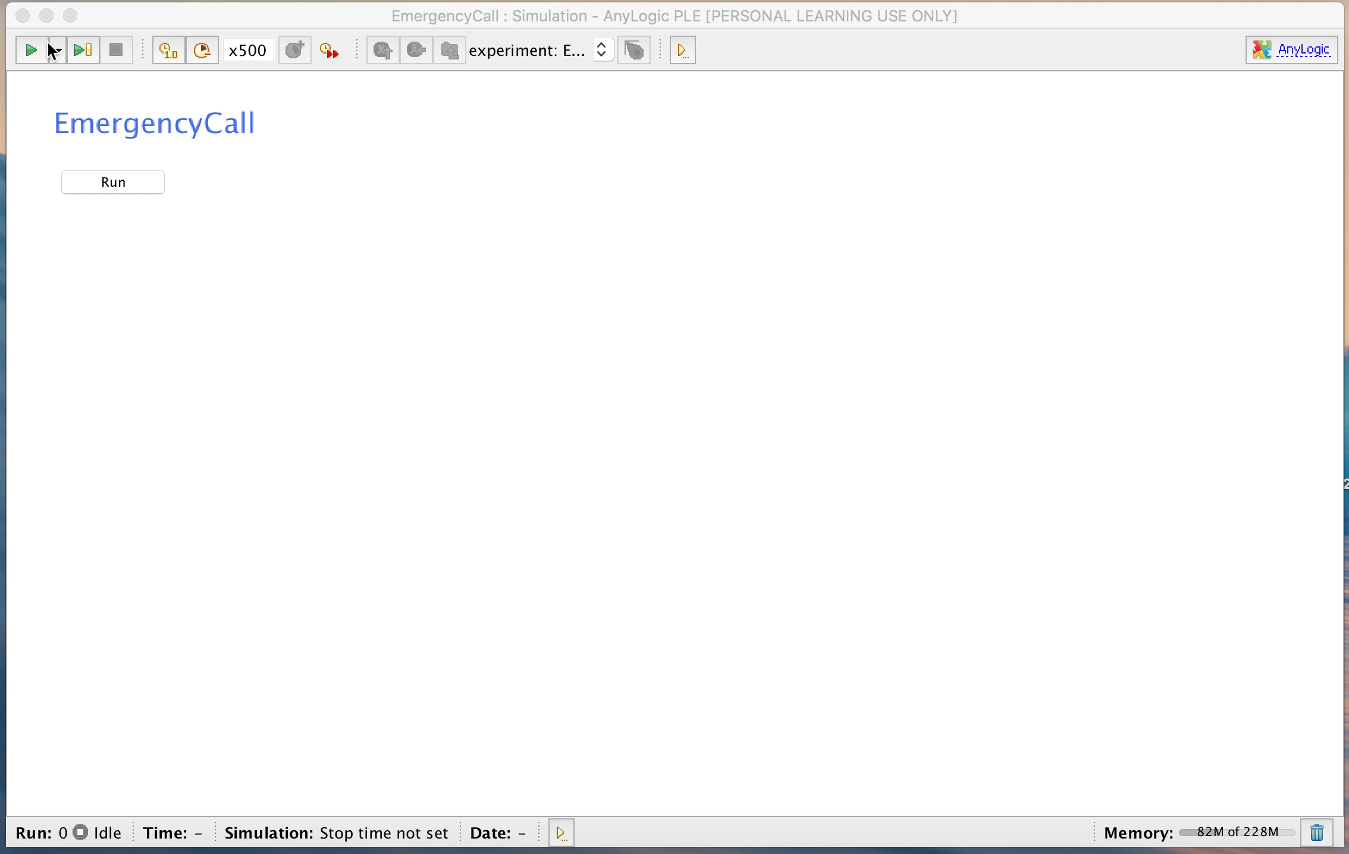
Demo

Slide 14
References

